Slide 1
Learning outcome:
To be able to identify differences between animal plant cells

Slide 2
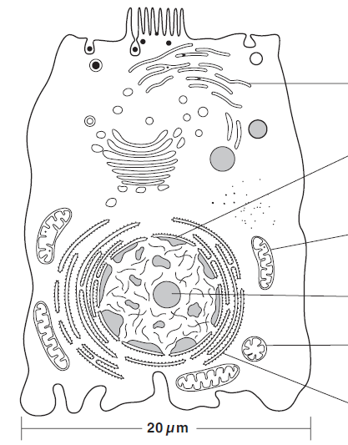
Animal Cell
Endocytosis
Microvilli
Transport Vesicles
Smooth endoplasmic reticulum
Lysosomes
Golgi Apparatus
Nuclear Membrane
Mitochondria
Nucleolus
Mitochondria
Rough Endoplasmic Reticulum

Slide 3
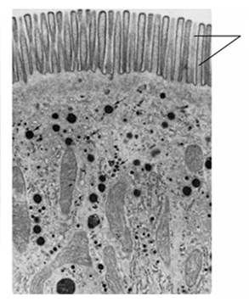
Epithelial cell lining the small intestine
How the epithelial cells is adapted for the rapid absorption of glucose
Microvilli
Mitochondria

Slide 4
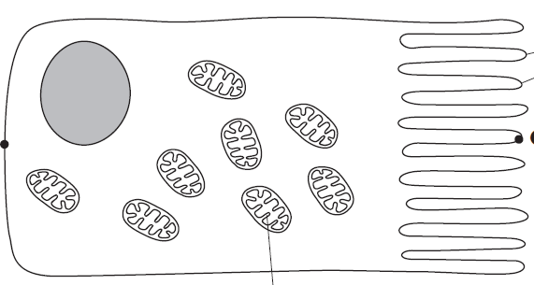
Epithelial cell lining the small intestine
How the epithelial cells is adapted for the rapid absorption of glucose
Microvilli increase surface area for the attachment of glucose transporter
Mitochondria supply ATP/energy for active transport
Microvilli contain carrier proteins for active transport and channel proteins for facilitated diffusion of glucose into the cell

Slide 5
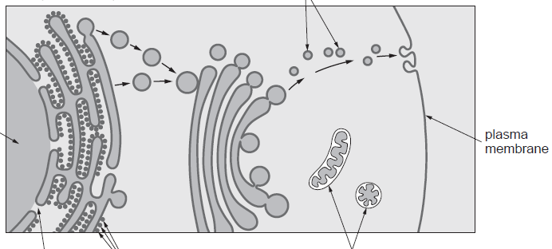

Part of a cell in the pancreas which produces and secretes digestive enzymes
DNA used to make mRNA
Transport Vesicles
Vesicles
Enzymes are packaged into vesicle
Vesicle fuses with cell surface membrane and the protein is secreted
DNA
Nuclear pore
Rough Endoplasmic Reticulum
Mitochondria
Golgi Apparatus
mRNA leaves nucleus and attaches to RER
Provide energy for enzyme synthesis
Enzymes are modified in Golgi apparatus
RER synthesise enzyme

Slide 6
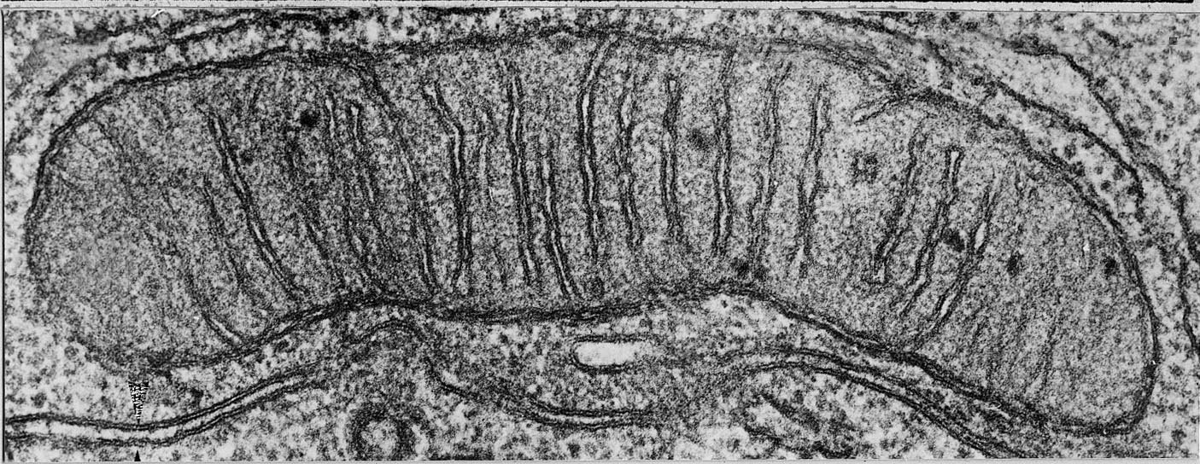
ELECTRON MICROGRAPH
OF MITOCHONDRION
endoplasmic
reticulum
fluid matrix
cristae
outer
membrane

Slide 7
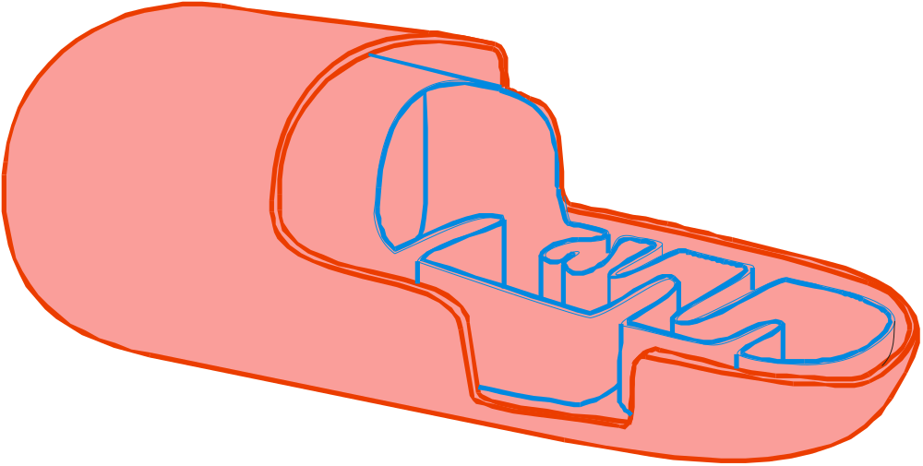
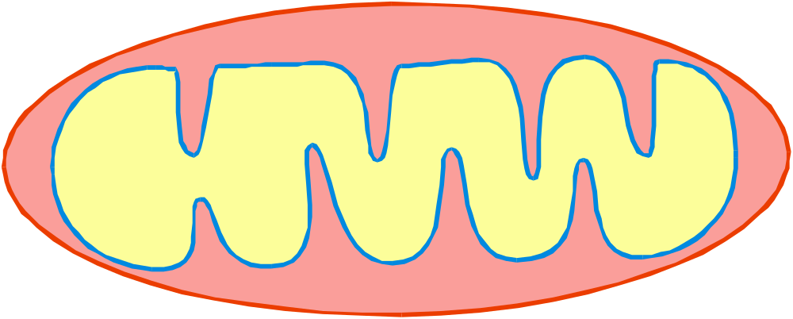
The inner membrane is folded into
cristae
Outer smooth
membrane
Inner folded membrane
Critae increase the surface area for the attachment of
enzymes involved in aerobic respiration
Fluid matrix
Contain enzymes
involved in respiration
THE POWERHOUSE OF THE CELL

Slide 8
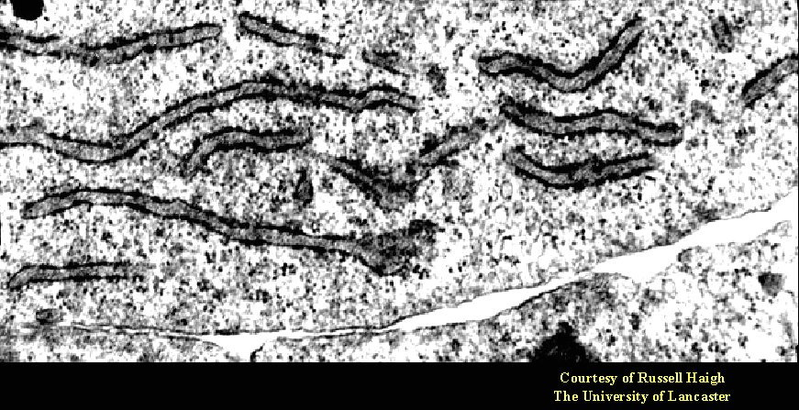
ELECTRON MICROGRAPH OF
ROUGH ENDOPLASMIC RETICULUM
cavity of
endoplasmic reticulum
ribosomes

Slide 9
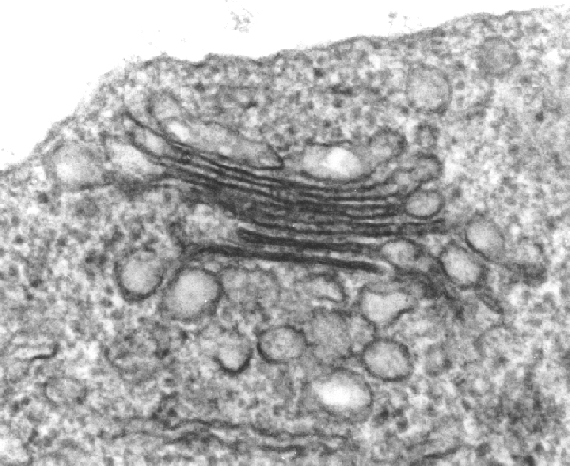
ELECTRON MICROGRAPH
OF GOLGI APPARATUS
stacked
membranes
Golgi
vesicles

