Slide 1
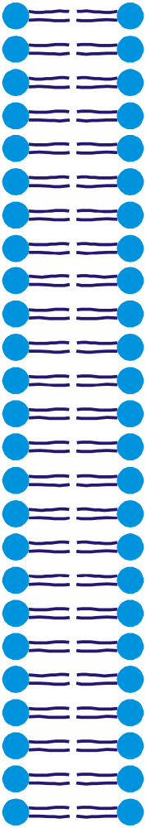


PERMEABILITY OF THE PHOSPHOLIPID BILAYER
High permeability
HYDROPHOBIC
MOLECULES
O₂
N₂
H₂O
CO₂
Urea
Glycerol
SMALL UNCHARGED
MOLECULES
LARGE UNCHARGED
POLAR MOLECULES
Glucose
Sucrose
Na⁺ K⁺
Cl⁻ Ca²⁺
Mg²⁺ HCO³⁻
IONS
Phospholipid bilayer
Carrier and channel proteins in the membrane transport large uncharged polar molecules and ions across cell membranes
Low permeability
How do polar molecules such as glucose and ions cross the membrane?

Slide 2
Methods of transport across cell surface membrane
Diffusion: Oxygen, water, urea and fat-soluble molecules
Active transport: absorption of nitrate/magnesium ions by root hair cells; amino acids/glucose by epithelial cells in the small intestine
Facilitated diffusion: transporting ions, amino acids, sugars
Osmosis: Diffusion of water
Bulk transport: exocytosis: releasing enzymes into the gut, releasing hormones into the blood; endocytosis: engulfing bacteria by phagocytes, food particles by single cell organisms
Co-transport: Transporting sodium ions and glucose by facilitated diffusion and active transport

Slide 3
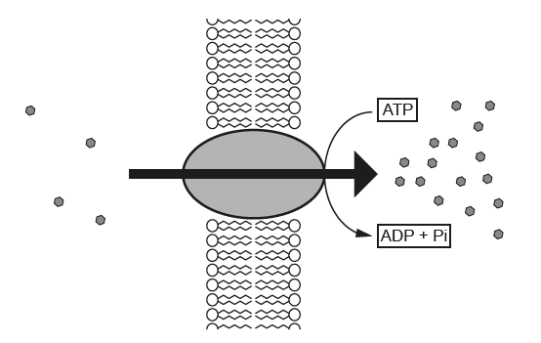
Active Transport
Phospholipid bilayer
Low concentration
High concentration
Carrier protein
Features of Active Transport:
Carrier protein
Energy (ATP)
Low to high concentration
Moves all of the substance from an area with low concentration to an area with higher concentration resulting in zero concentration on one side
Substances are transported one way across the membrane

Slide 4
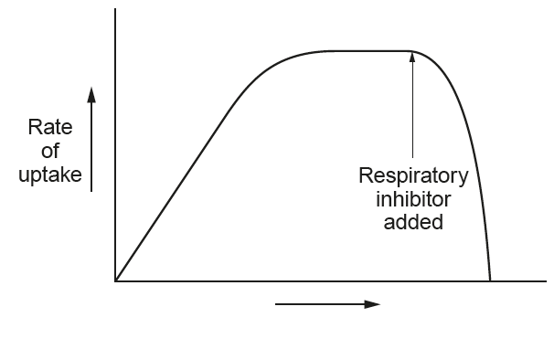
Active Transport
Rate levels out when all carrier proteins’ binding sites are occupied / saturated
Concentration gradient across membrane
Respiratory inhibitor stops respiration, so ATP production stops and the rate of active transport stops

Slide 5
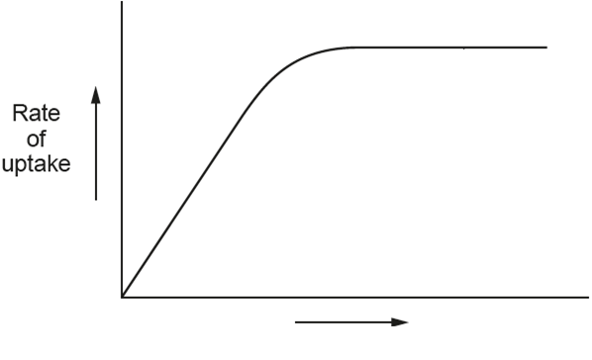
Facilitated Diffusion
Rate levels out when all carrier proteins’ binding sites are occupied / limited / saturated
Rate of uptake increases as concentration gradient across membrane increases
Concentration gradient across membrane
Features of Facilitated Diffusion:
Carrier protein / channel protein in cell membrane
Passive / No ATP
High Concentration to low concentration
Moves substance both directions until concentration becomes equal on both sides of the membrane

Slide 6
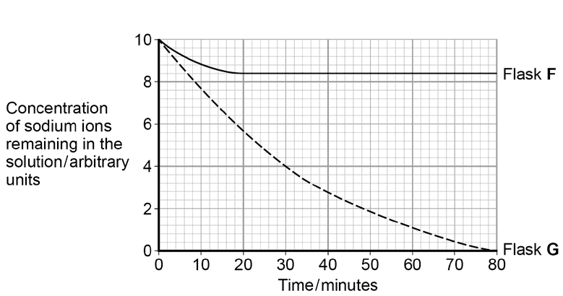
Identifying the method of uptake of sodium ions by cells in flasks F containing inhibitor of ATP and G without the inhibitor
In Flask G uptake occurs by active transport because:
ATP is present for the active transport
All of the sodium ions have been absorbed from the flask G
Uptake in flask F occurs by facilitated diffusion as it levelles off when sodium ion concentrations inside and outside cells becomes equal after 20 minutes

Slide 7
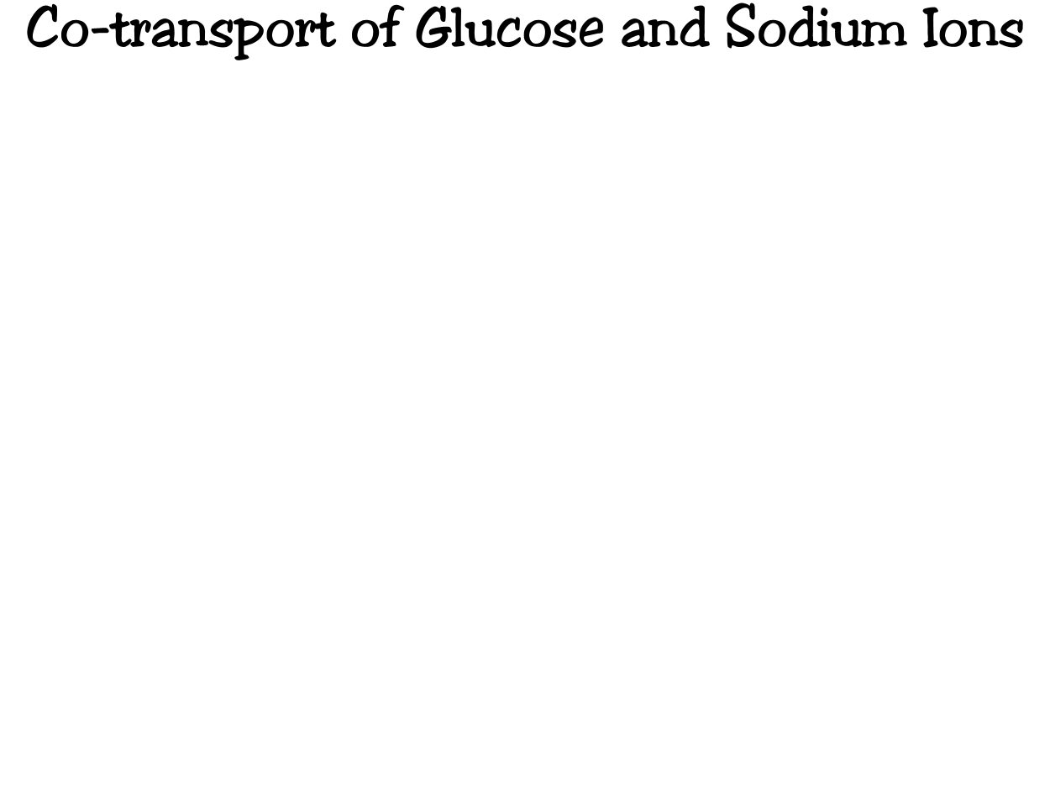
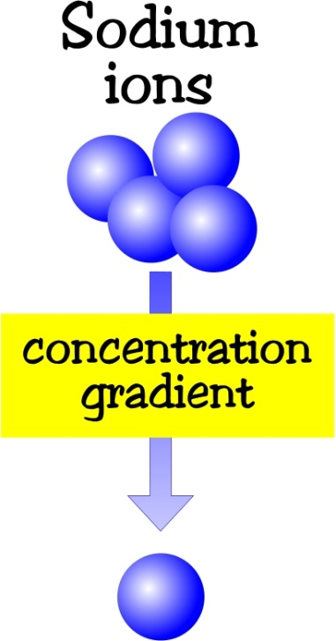
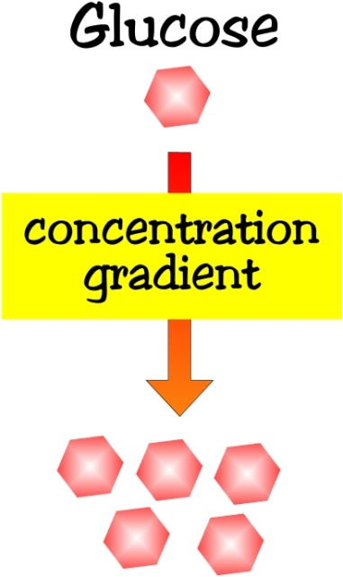
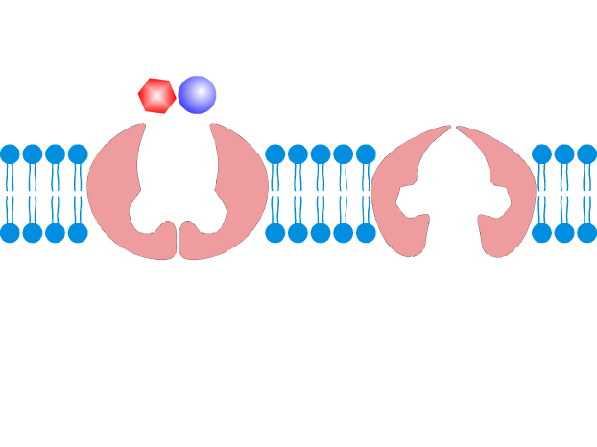
Co-transport carrier protein in cell membrane of small intestine has binding sites for both glucose and sodium ions
Lumen of small intestine
Cell lining the small intestine small intestine
Na⁺ diffuses through co-transport carrier proteins down this concentration gradient taking glucose with it, so both and Na⁺ glucose go together

Slide 8
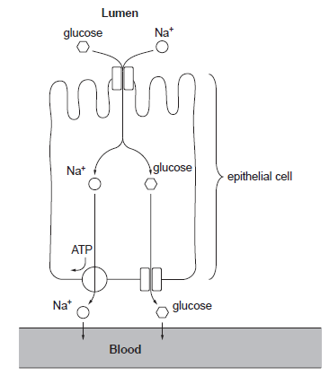
Co-transport
Two molecules are transported together by
Facilitated Diffusion
Active Transport
Na⁺ ions diffuse into cells down concentration gradient by facilitated diffusion from lumen taking glucose with them
Active transport of Na⁺ ions into blood by a carrier protein keeps Na⁺ ions concentration low within the cell

Slide 9
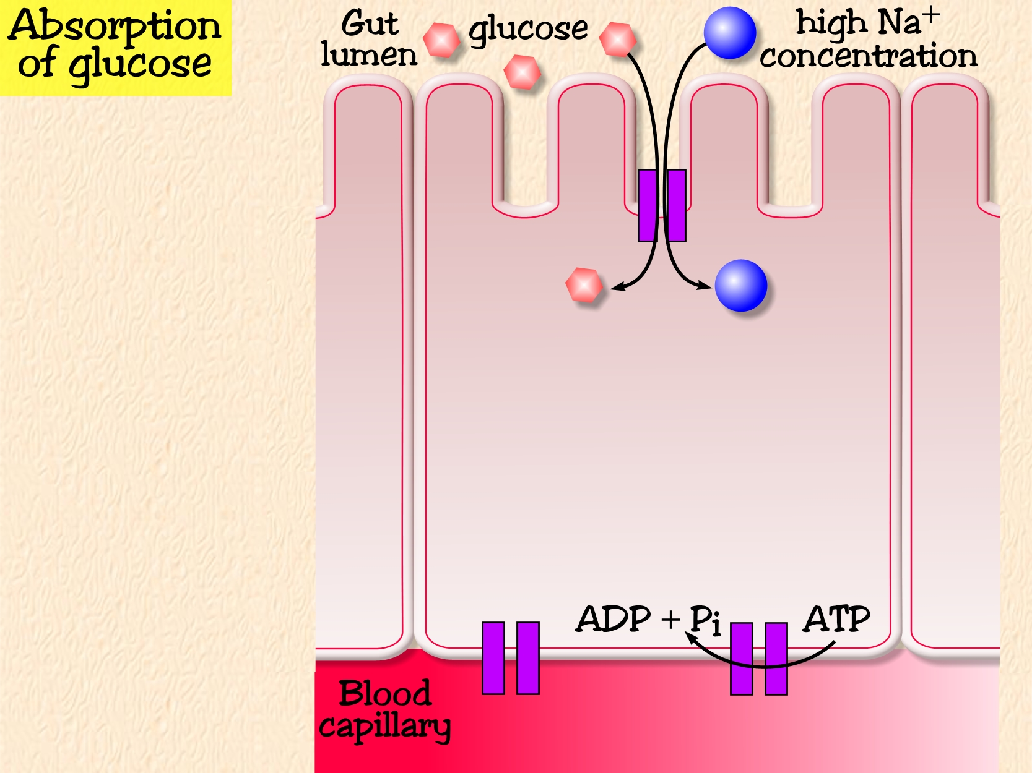
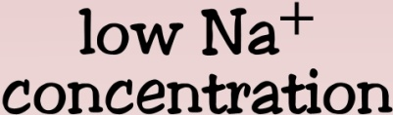
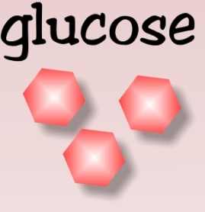
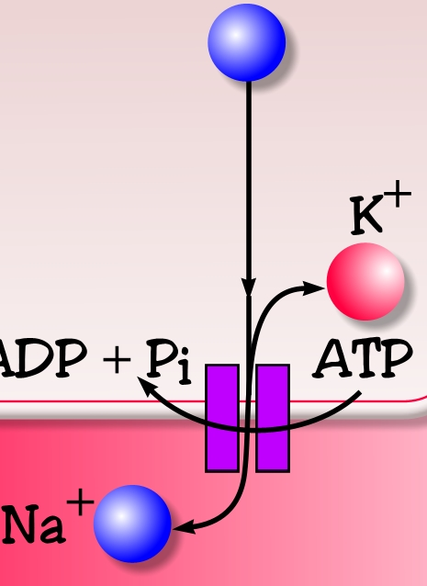
Co-transport of glucose and Na⁺
ions
Co-transport carrier protein binds both Na⁺ and glucose
Na/K pump actively transports Na⁺ out of the cell into the blood
Lowering Na⁺ concentration inside cell causing facilitated diffusion of Na⁺ ions together with glucose by the co-transport protein
A glucose channel protein transports glucose into the tissue fluid by facilitated diffusion
Glucose diffuses from the tissue fluid into the blood capillaries by simple diffusion

Slide 10
Transport Across Membranes
SIMPLE DIFFUSION
Simple diffusion is the NET movement of of ions or molecules down their
concentration gradient i.e. from regions of HIGH concentration to regions
of LOW concentration
Net directional movement
continues until there are
equal concentrations on
either side of the membrane
High concentration
of molecules
Low concentration
of molecules
Diffusion continues until
equilibrium is reached
Net direction of movement

Slide 11
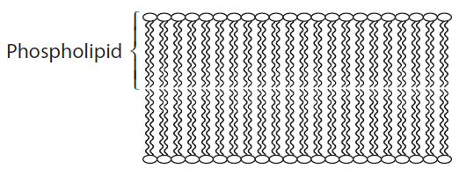
Simple Diffusion
Diffusion occurs due to concentration difference (concentration gradient) outside and inside the cell.
Rate of diffusion decreases as the concentration gradient decreases.
Rate of diffusion increases as the concentration gradient increases.
Net diffusion stops when concentration inside cell equals that outside the cell.
surface area x steepness of concentration gradient
Rate of diffusion =
thickness of membrane
The larger the surface area
The steeper the concentration gradient
The thinner the membrane
THE FASTER THE RATE OF DIFFUSION

Slide 12
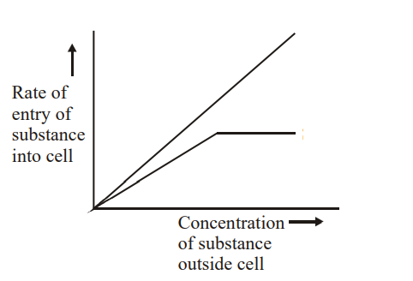
Comparing Simple diffusion and facilitated diffusion
Simple diffusion
Facilitated diffusion
Simple Diffusion
Moves a substance through the phospholipid bilayer down a concentration gradient
Rate of uptake is proportional to concentration of the substance
Facilitated diffusion occurs through a channel / carrier protein
Rate levels out when all carrier proteins’ binding sites are occupied / limited / saturated

Slide 13
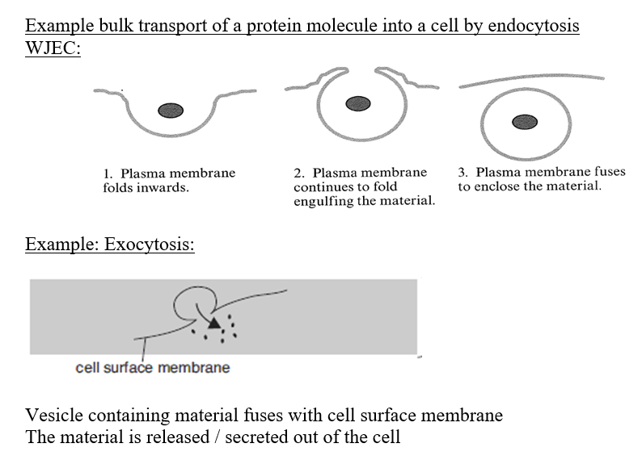
Endocytosis and exocytosis

Slide 14
Active transport | Simple diffusion | Facilitated diffusion
Require energy – ATP Rate increases as respiration rate increases (requiring oxygen and glucose) | Passive – No energy (ATP) | Passive – No energy (ATP)
Carrier protein | Through the phospholipid bilayer | Carrier protein / Channel protein
Limited by the number carrier proteins- Rate / graph levels out reaching maximum | Linear relationship between Rate and solute concentration | Limited by the number carrier proteins- Rate / graph levels out reaching maximum
Against concentration gradient | Down concentration gradient | Down concentration gradient
Carrier protein bind specific ions / molecules |  | Carrier protein bind specific ions / molecules
Molecules or ions move only one way across the membrane, moving all of the substance to one side against concentration gradient | Molecules or ions move either way across the membrane until concentration is equal on both sides | Molecules or ions move either way across the membrane until concentration is equal on both sides

Slide 15
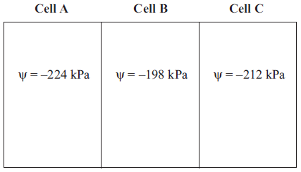
Osmosis
Osmosis is the diffusion of water from an area of higher water potential (Ψ) to an area of lower water potential through a partially permeable membrane
Water potential (Ψ) is measured in units of pressure kiloPascals (kPa).
Water potential (Ψ) is the pressure created by water molecules
Under standard conditions of 25 ⁰C and 100 kPa, pure water has water potential 0
Water potential of a cell, Ψ
Water potential is the tendency for water molecules to move in and out of a cell
The less negative the value, the greater the tendency for water to move out of a cell
Osmosis
Osmosis

Slide 16


Osmosis
Water molecules are
small enough to pass
through the partially permeable membrane
Partially permeable membrane with
pores
Osmosis
sugar molecules
too large to pass
through pores
in the membrane
Dilute solution – less concentration
CONCENTRATED SOLUTION- more sugar

Slide 17
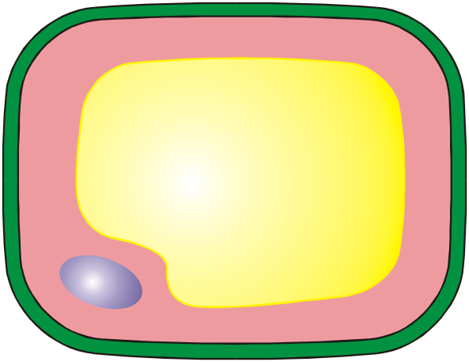
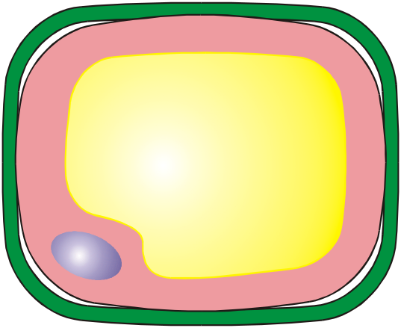
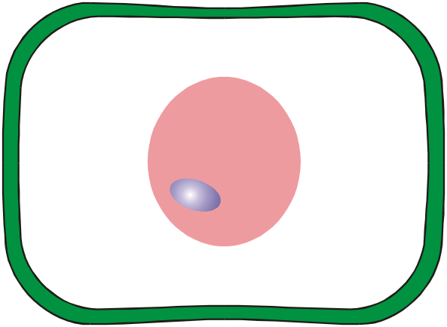
PLANT CELLS AND OSMOSIS
The osmosis behaviour of plant cells immersed in various solutions depends upon the
concentration in the cell and the concentration of the surrounding solution
This plant
cell has been placed in
a dilute solution
This plant cell has been
placed in a solution that has
the same concentration as the plant cell
This plant cell has been
placed in a solution which is
more concentrated than the
cytoplasm
There is net movement of water by osmosis is into the cell, the mass of the cell increases and the cytoplasm swells and presses against the cell wall
There is no net movement of
water in this case and no
change in cell mass
The net movement of water
by osmosis is out of the cell, the cell shrinks and the cell mass decreases
The cytoplasm is pulled
away from the cell wall and the cell is plasmolysed (flaccid)

Slide 18
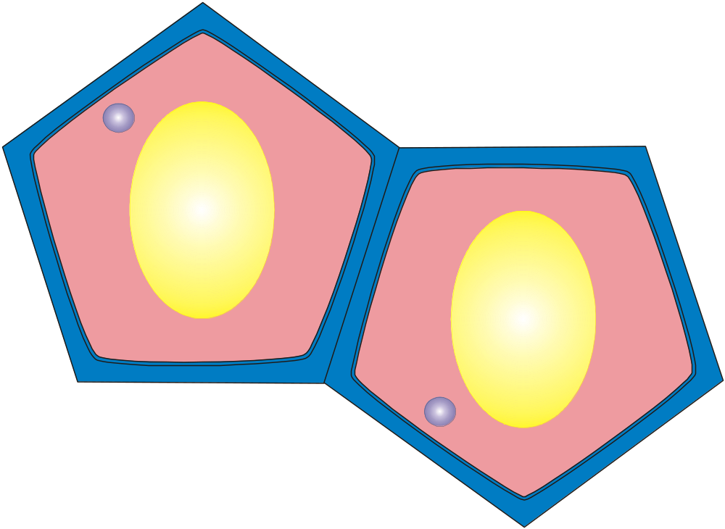
SOLVING WATER POTENTIAL PROBLEMS
CELL B
Concentration= 10
mol dm⁻³
Concentration = 20
mol dm⁻³
Osmosis
CELL A
Cell A is less concentrated than Cell B , so water moves from cell A into cell B
by osmosis

Slide 19

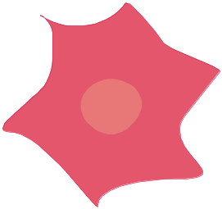
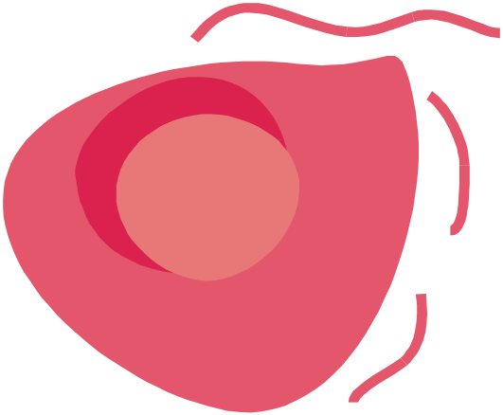
ANIMAL CELLS AND OSMOSIS
When placed in an isotonic solution, there is
no net loss or gain of water and the cell’s water
content remains constant
When placed in a hypertonic solution, the cells
lose water by osmosis and shrink.
When placed in a hypotonic solution, the cells
gain water by osmosis and burst

Slide 20

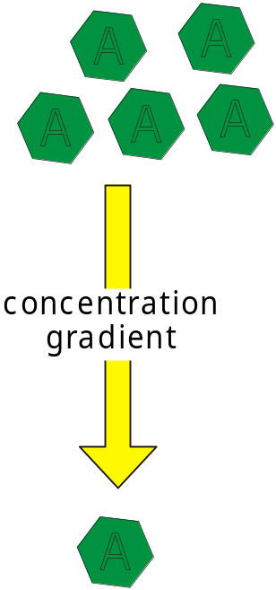
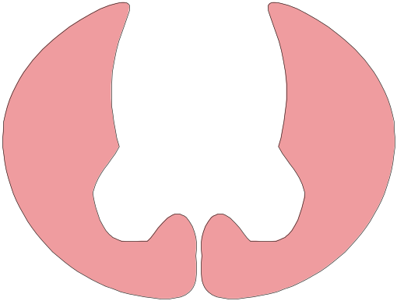
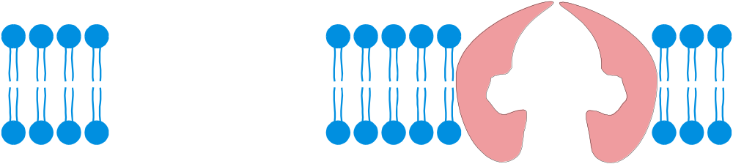
Lipid
Bilayer
concentration
gradient

Slide 21
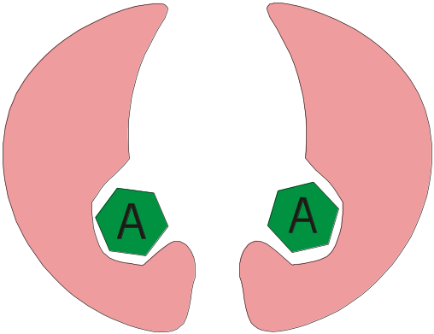
Lipid
Bilayer
concentration
gradient

Slide 22
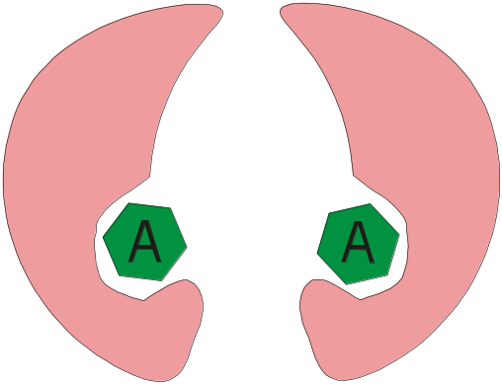
Lipid
Bilayer
concentration
gradient

Slide 23
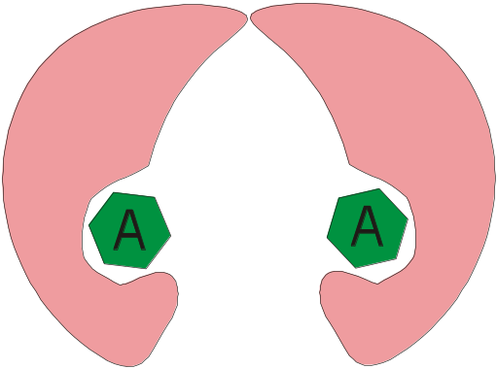
Lipid
Bilayer
concentration
gradient

Slide 24
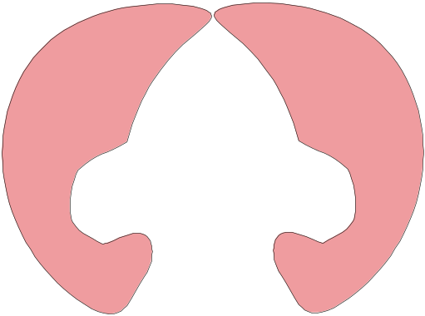


Lipid
Bilayer
concentration
gradient

Slide 25
Lipid
Bilayer
concentration
gradient

Slide 26
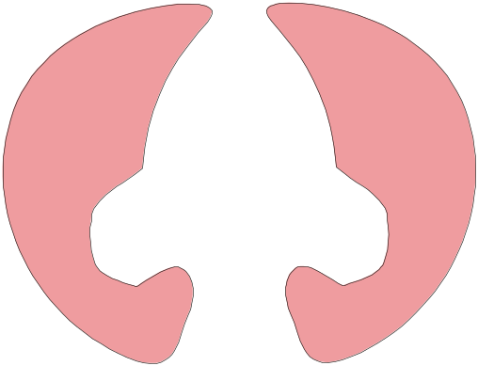
Lipid
Bilayer
concentration
gradient

Slide 27
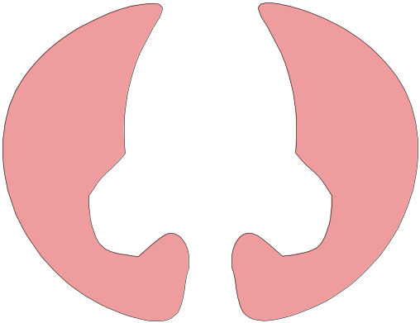
Lipid
Bilayer
concentration
gradient

Slide 28

Lipid
Bilayer
concentration
gradient

Slide 29
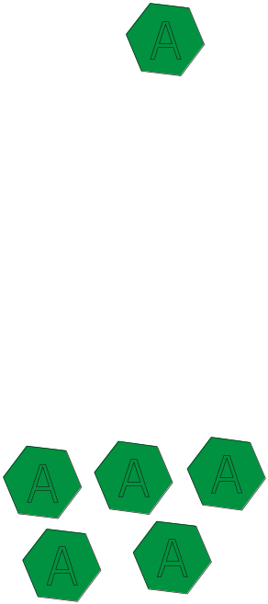
Active Transport
Intrinsic proteins
within the membrane
function as carriers for the
active transport of molecules
across membranes
Lipid
Bilayer
concentration
gradient
Active transport is an energy –
requiring transport system that
is able to transfer material
against a concentration gradient
Many different ions are actively
transported across membranes
as is glucose when being absorbed
from the gut into the blood stream

Slide 30

Molecules attach to the specific carriers
ATP attaches to the carrier
energy
energy
ADP
ATP
Lipid
Bilayer
concentration
gradient
Hydrolysis of ATP provides the energy
for the protein carriers to change shape
and transport the molecules across
the membrane

Slide 31
Lipid
Bilayer
concentration
gradient

Slide 32
Lipid
Bilayer
concentration
gradient

Slide 33
Lipid
Bilayer
concentration
gradient

Slide 34
Lipid
Bilayer
concentration
gradient

Slide 35
Lipid
Bilayer
concentration
gradient

Slide 36
Lipid
Bilayer
concentration
gradient

Slide 37
Lipid
Bilayer
concentration
gradient

Slide 38
Lipid
Bilayer
concentration
gradient
As active transport is dependent upon a supply of ATP from aerobic respiration,
then the mechanism is affected by temperature, oxygen availability
and cellular glucose concentrations

Slide 39
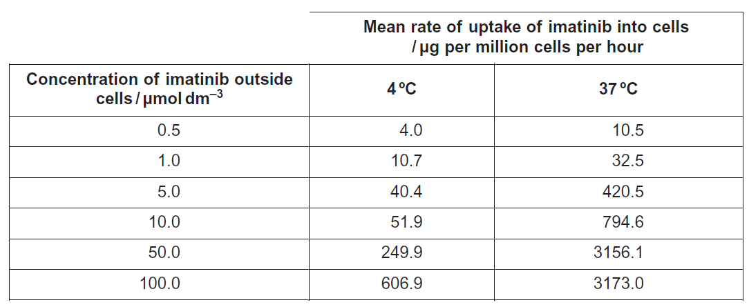
Active transport
The rate of uptake increases by 203.7% at 1.0 μmoldm^{–3}.
At all concentrations the rate of uptake is faster at 37 ºC
Rate levelling out at higher concentration, so the uptake must be active transport. All the carrier protein occupied by imatinib
Respiration is faster at higher temperature, releasing more energy for the active transport

Slide 40
Active transport/facilitated diffusion
Example: Investigating the uptake of sodium ions by animal tissue in flasks F containing inhibitor of ATP and G without the inhibitor.
In Flask G uptake occurs by active transport because:
ATP present in flask G provide the energy for the active transport, which is a energy requiring process
All of the sodium has been absorbed from the flask G, showing uptake against a concentration gradient

Slide 41
Active transport/facilitated diffusion
Example: Investigating the uptake of sodium ions by animal tissue in flasks F containing inhibitor of ATP and G without the inhibitor.
Uptake in Flask F occurs by facilitated diffusion because:
Uptake in flask G levelled off after 20 minutes
When sodium ion concentrations in solution and in cells becomes equal / equilibrium reached

Slide 42
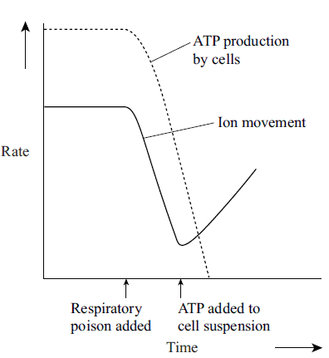
Active transport
Investigation of the effect of respiratory poison and ATP addition on the rate of ion movement and the rate of ATP production in a suspension of cells
Ion movement goes down when the poison is added and rises when ATP added because:
Ion movement is by active transport
ATP / energy needed for active transport
Respiration provides ATP / energy
Poison inhibits/stops respiration / ATP production

